Slide 1

String and StringBuffer
Example1
Hello
String
  In Java String is a class.
  It is immutable
  It is final class
  It is also a data type in Java
Example 1:
String a=”Hello”;
String b=new String();
String c=new String(“Hello”);
Example2 :
String a=”Hello”;
String b=”Hello”;
String c=new String(“Hello”);
if(a==b)
System.out.println(“Same reference “);
if(a==c)
System.out.println(“Same Reference of A and C “);
else
System.out.println(“Not Same Reference “);
a
b
Hello
c
Hello
a
b
Hello
c
Example2

Slide 2
String Methods
1 ) concat(String a)- Concate one string content into another string.
Example:
String a=”Hello”;
System.out.println(a.concat(“Bye”); //Output is HelloBye
System.out.println(a); //Output is Hello
2) toLowerCase()- Convert String into small case.
Example:
String a=”Hello”;
a=a.toLowerCase(); // a value is hello
3)charAt(int index)-Returns the character located at the specified index.
Example:
String a=”Hello”;
System.out.println(a.charAt(1)); //output is e
4) equalsIgnoreCase(String a)- Determines the equality of two strings, ignoring case.
Example:
String a=”Hello”;
String b=”HELLO”;
if(a.equalsIgnoreCase(b))
System.out.println(“Equals “);
else
System.out.println(“Not Equals”);

Slide 3
String methods continued......
5) length()- Returns the number of characters in a String.
Example:
String a=”Hello”;
System.out.println(a.length()); //output is 5
6) replace(char old,char new)- Replaces occurrences of a character with a new character.
Example:
String a=”Hello”;
System.out.println(a.replace('l','w'); //output is Hewwo
7) subString()- Returns a part of String
Example:
String a=”Hello”;
System.out.println(a.subString(2)); System.out.println(a.subString(2,4));
8) trim()- Removes whitespace from the ends of a string.
Example:
String a=” hi ” ;
System.out.println(a.trim()+”Tim”);
9) indexOf(String a)- Search a character from given String
Example:
String a=”Hello”;
System.out.println(a.indexOf(“e”)); //output is 2

Slide 4
String methods continued......
10) split()-J2SE 1.4 added the split() method to the String class to simplify the task of breaking a string into substrings, or tokens.
Example:
String a=”This is a String Object”;
String x[]=a.split(“ “);
for(i=0;i<x.length;i++)
{
System.out.println(x[i]);
}

Slide 5
TEST YOUR SELF

Slide 6
String
Test Your Self
1) What will be the output of the following code?
String a=”Hello”;
String b=”Hello”;
String c=new String(“Hello”);
String d=new String(“HELLO”);
if(a.equals(d))
System.out.println(“Same Value “);
else
System.out.println(“Not Same Value “);
if(a==c)
System.out.println(“Same Reference”);
else
System.out.println(“Not Same Reference “);

Slide 7
String
Test Your Self
2) What will be the output of the following code?
String s1=”Summer” ;
String s2=s1+” Spring” ;
s2.concat(“Fall”);
s1=s1+”Winter”);
System.out.println(s1+ “ “+s2);
3) Which methods String class have
a) reverse()
b) append()
c) replace()
d) charAt()

Slide 8
String
Test Your Self
4) What will be the output of the following code?
String x = "abc";
String y = x.concat("def").toUpperCase().replace('C','x');
System.out.println(y);
5) What will be the output of the following code?
String a=”Hello”;
a.concat(“Java”);
a.toUpperCase();
a.replace('e','w');
System.out.println(a);

Slide 9
Test Your Self
6) How to inherit a String class
a) class A extends String
b) class A implements String
c) Cannot inherit String class because it is declared final
d) class A : public String

Slide 10
StringBuffer
The java.lang.StringBuffer classes should be used when you have to make a lot of modifications to strings of characters.
As we discussed in the previous section, String objects are immutable , so if you choose to do a lot of manipulations with String Objects, you will end up with a lot of abandoned String objects in the String pool.
Example:
StringBuffer sb=new StringBuffer(“Hello”);
sb.append(“Java”);
System.out.println(sb); //HelloJava
Note: In Jdk1.5 a new class is added StringBuilder, this class has same method as StringBuffer. The only difference between StringBuilder and StringBuffer is, StringBuffer is synchronized and StringBuilder is not synchrnoized,, and it is faster than StringBuffer.
Hello
Java
sb
Updates the original String

Slide 11
StringBuffer methods
1) append(String s)- To append value on end , it can take boolean, float, int etc.
Example:
StringBuffer s=new StringBuffer(“Hello”);
s.append(true); //Output is Hellotrue
2) delete(int start,int end)- A substring is removed from the original object
Example:
StringBuffer s=new StringBuffer(“Hello”);
s.delete(2,4); //Heo
3) insert(int offset,String s)-To add value on desired location, and you can add any kind of value.
Example:
StringBuffer s=new StringBuffer(“1234567”);
s.insert(4,”----”); //1234---567
4) reverse()-To reverse an original String.
Example:
StringBuff er s=new StringBuffer(“Hello”);
s.reverse(); //olleH
5) deleteCharAt(int index)- Delete a character from given index.
StringBuffer s=new StringBuffer('Hello”);
s.deleteCharAt(2); //Helo

Slide 12
Exercise:
1) WAP to reverse a enter string using String class and StringBuffer class.
2) WAP to convert an entered string into proper case.
3) WAP to generate following output
Input : Space
Output : paceS
aceSp
ceSpa
cSpac
Space
4) WAP to check entered String is Palindrome String or not
Input : nitin
Output : Palindrome String
Input : amit
Output : Not Palindrome String

Slide 13
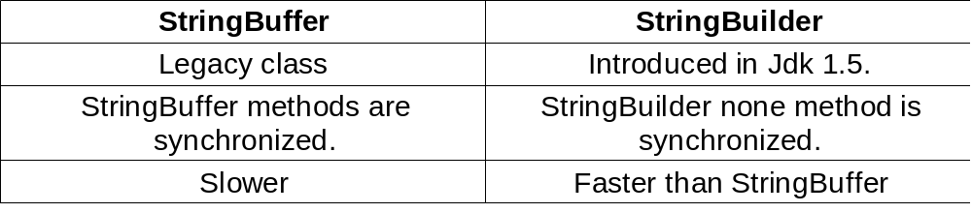
StringBuffer vs StringBuilder
Note:All methods of StringBuffer are same in StringBuilder class , but StringBuilder methods are not synchronized

